Slide 1
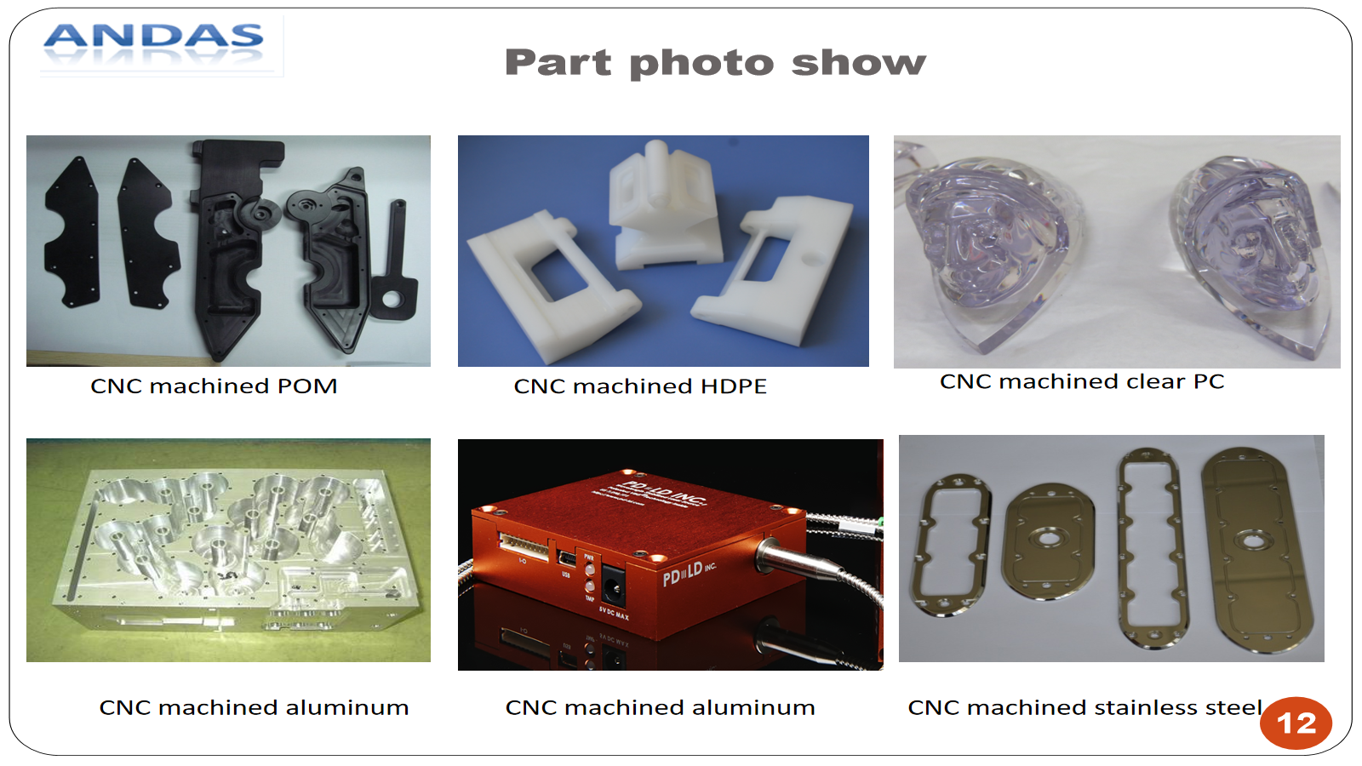
Andas CNC Prototyping & Flexible Small-Batch Manufacturing
3-axis CNC machining, prototype parts, finishing coordination and project-reviewed advanced capacity under Andas-authorized production.
ISO 9001 quality management
3-axis CNC core capability
Advanced capacity by project review
Andas Industrial Co., LTD | andas-industrial.com | ISO 9001

Slide 2
Who We Are
Andas provides practical prototyping and production follow-up for overseas engineering buyers.
• Andas-authorized production for CNC prototypes and flexible small-batch parts.
• Core work: 3-axis CNC milling, CNC turning, plastic and metal prototypes.
• Project follow-up covers quotation, production route, inspection plan, finishing and shipment.
• Advanced processes are reviewed by drawing, quantity, tolerance, material and lead time.
Andas Industrial Co., LTD | andas-industrial.com | ISO 9001

Slide 3
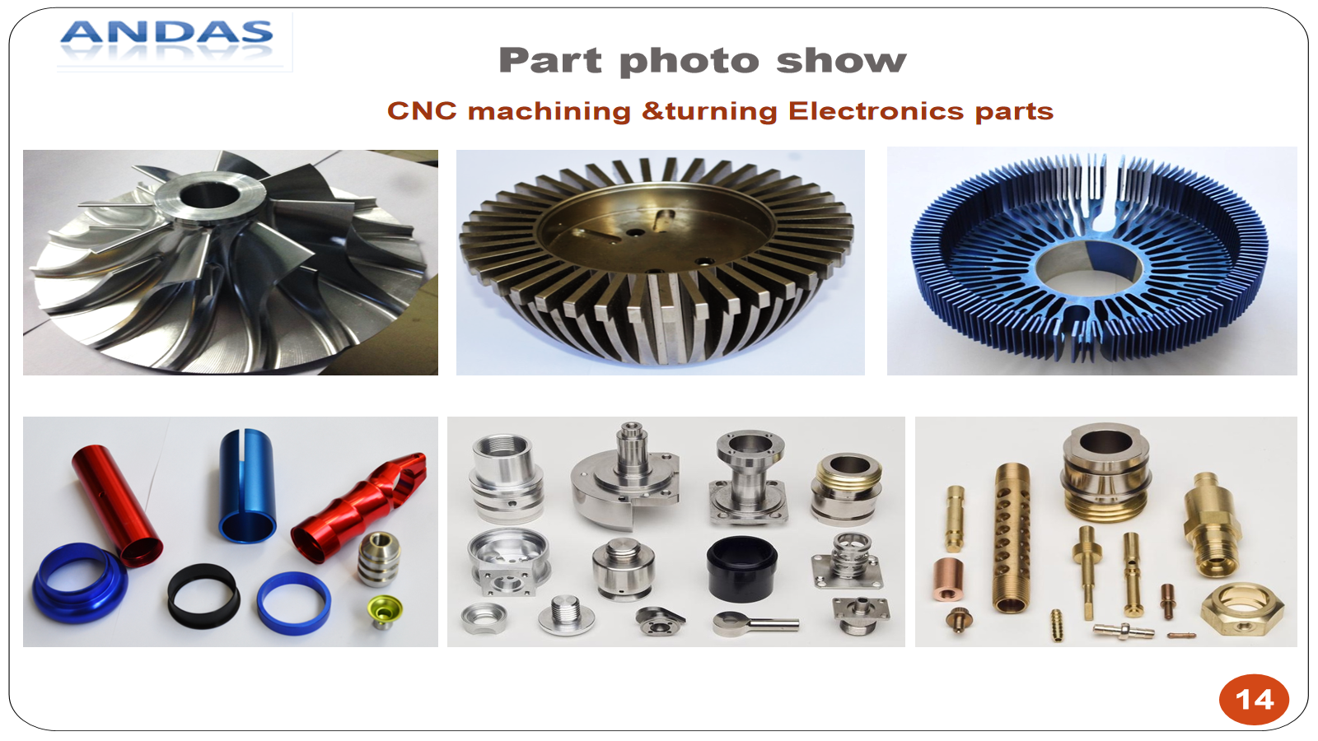
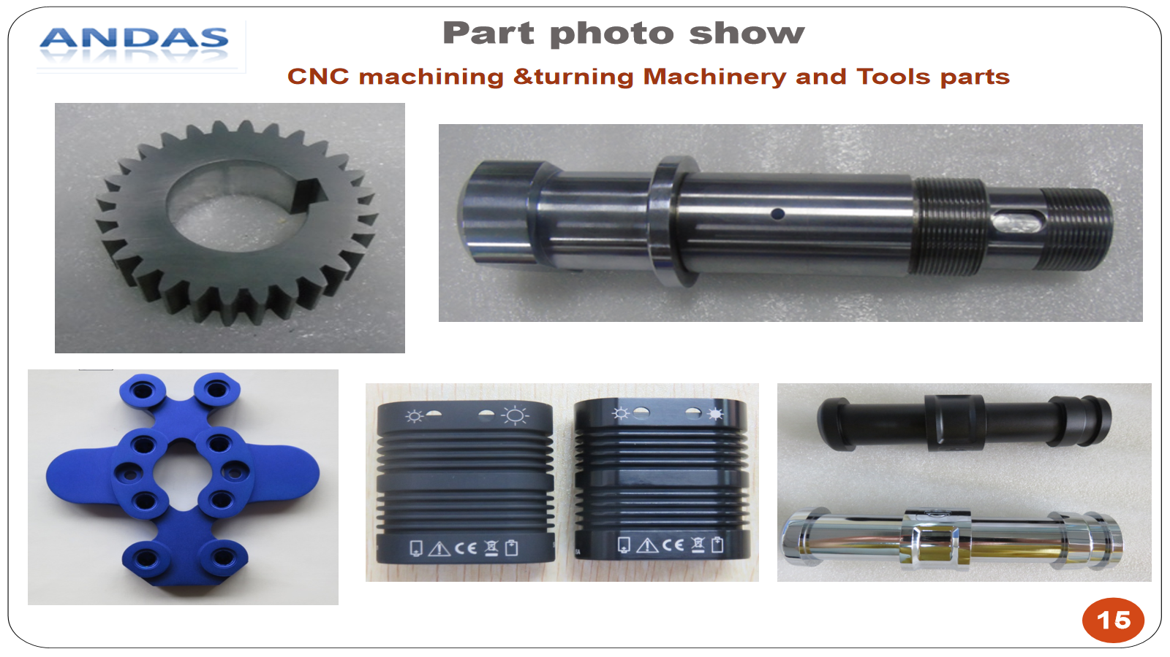
Core Production Focus
• 3-axis CNC milling
• CNC turning
• Plastic and metal prototypes
• Flexible small-batch production
• Surface finishing coordination
• Basic inspection and export packing
Andas Industrial Co., LTD | andas-industrial.com | ISO 9001

Slide 4
Advanced Capacity by Project Review
Not every advanced process is suitable for every small order. Andas confirms the production route before quotation.
• 5-axis machining for qualified geometry and quantities
• Larger or complex machining reviewed by drawing
• Vacuum casting for prototype plastic batches
• Sheet metal cutting, bending and welding support
• CMM or third-party inspection by project requirement
• Special finishing such as anodizing, painting, plating and sand blasting
Andas Industrial Co., LTD | andas-industrial.com | ISO 9001

Slide 5
Materials We Commonly Handle
• Metals: aluminum, stainless steel, steel, brass, copper
• Plastics: ABS, POM, PC, PMMA, Nylon, HDPE, PVC, PC+ABS, PEEK
• Vacuum casting: ABS-like, PP-like, rubber-like and PMMA-like materials
• Material availability, tolerance and finish are confirmed before quotation
Andas Industrial Co., LTD | andas-industrial.com | ISO 9001

Slide 6
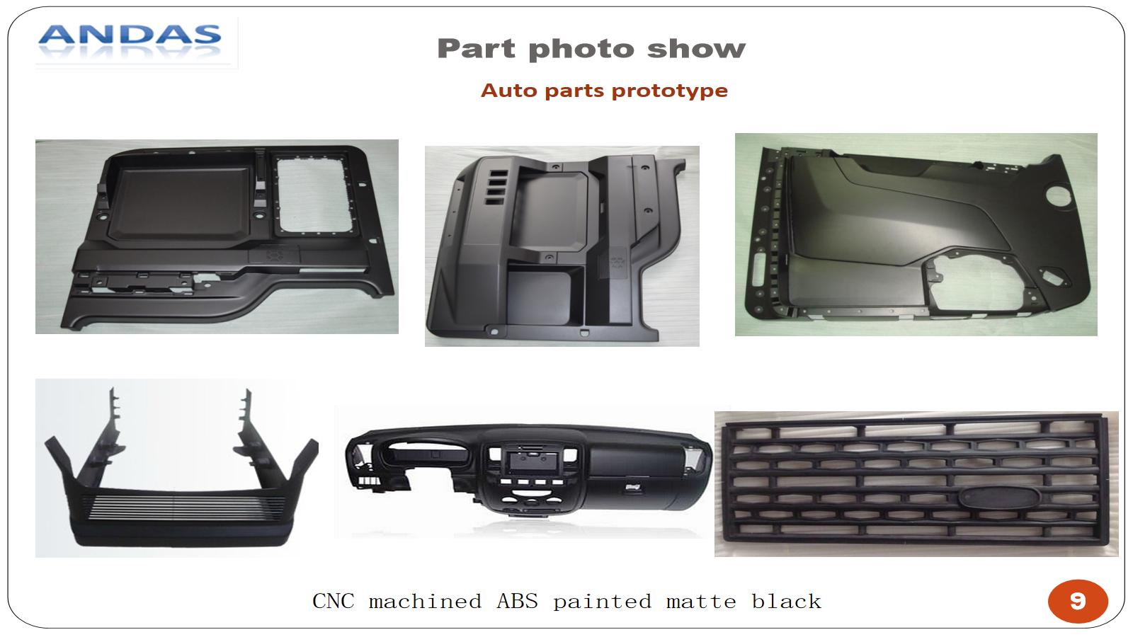
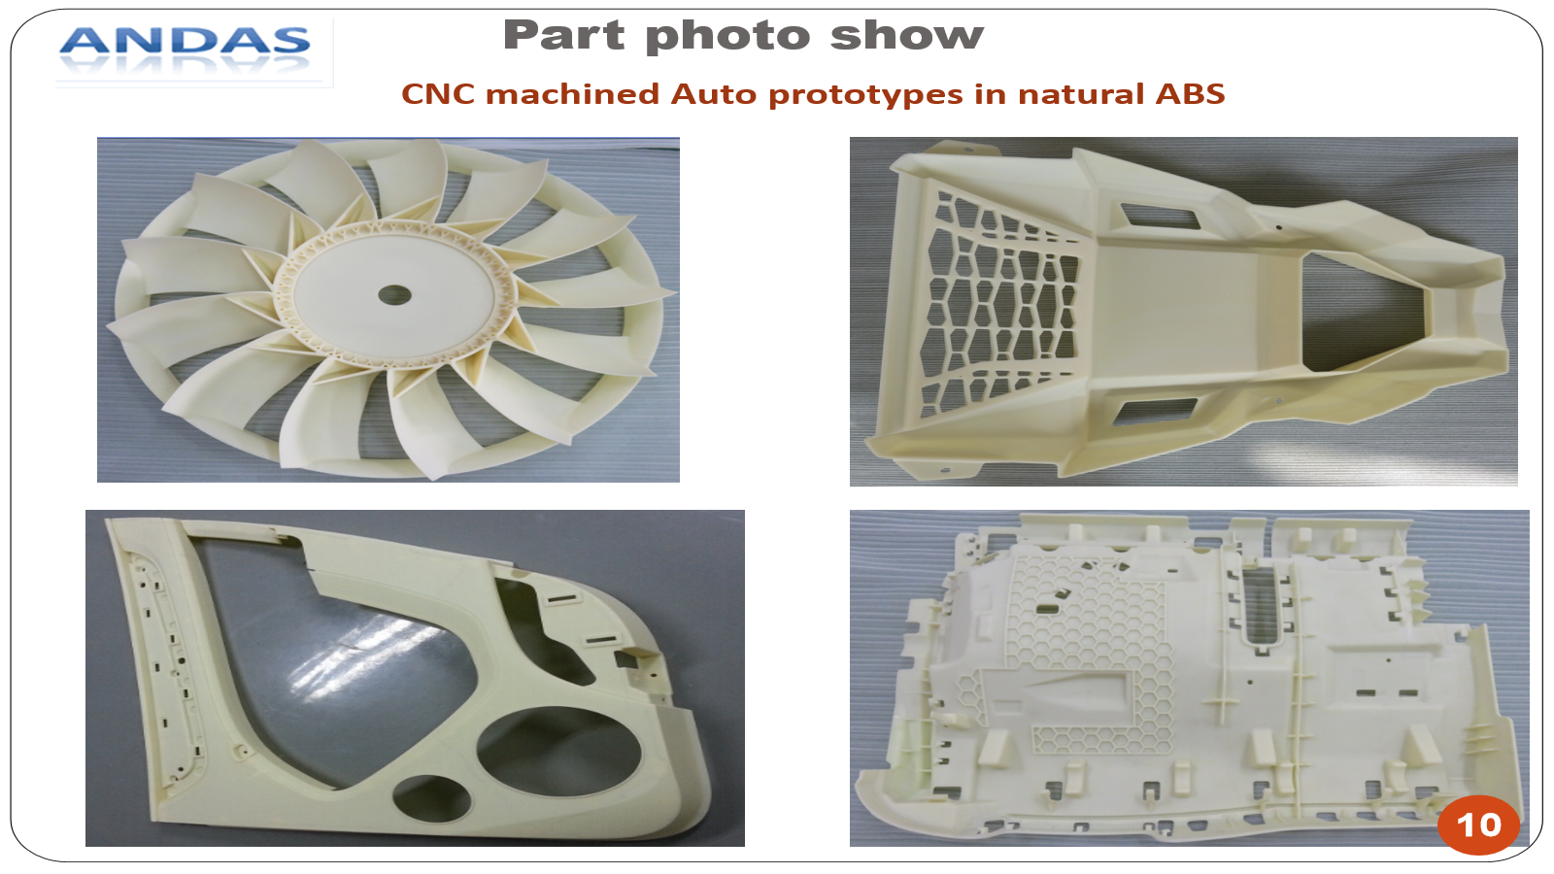
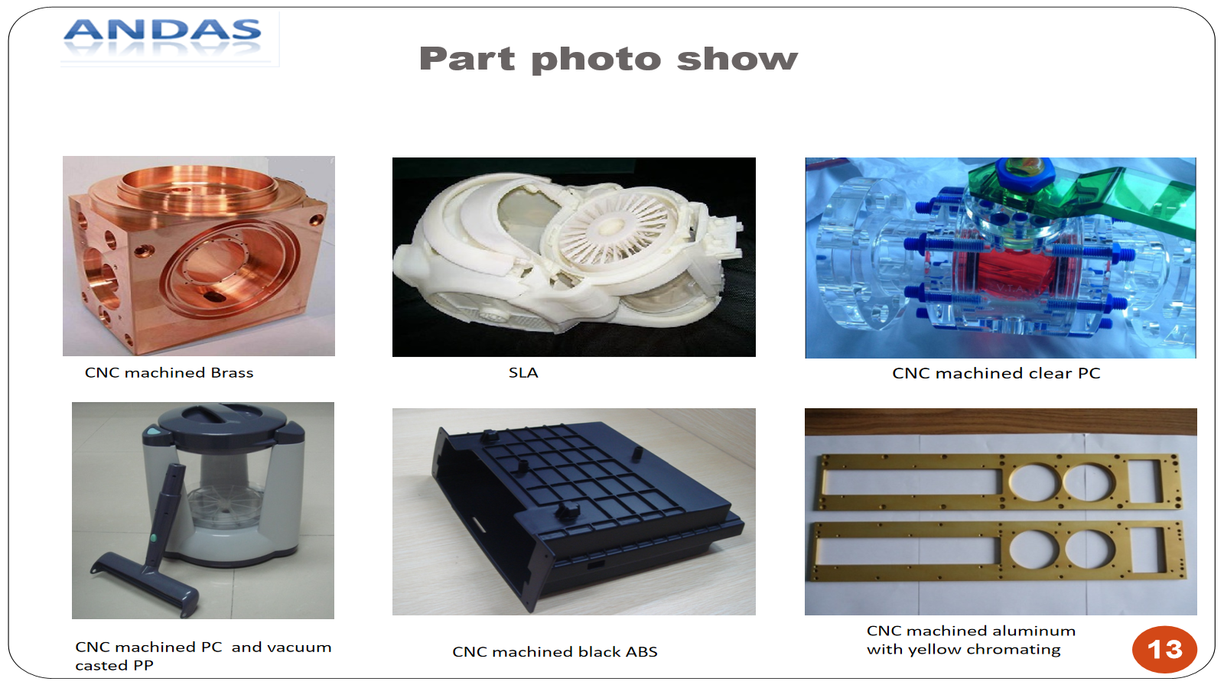
CNC Prototype Gallery
Real product examples from previous Andas prototyping materials; customer names and sensitive details are not shown.
Andas Industrial Co., LTD | andas-industrial.com | ISO 9001

Slide 7
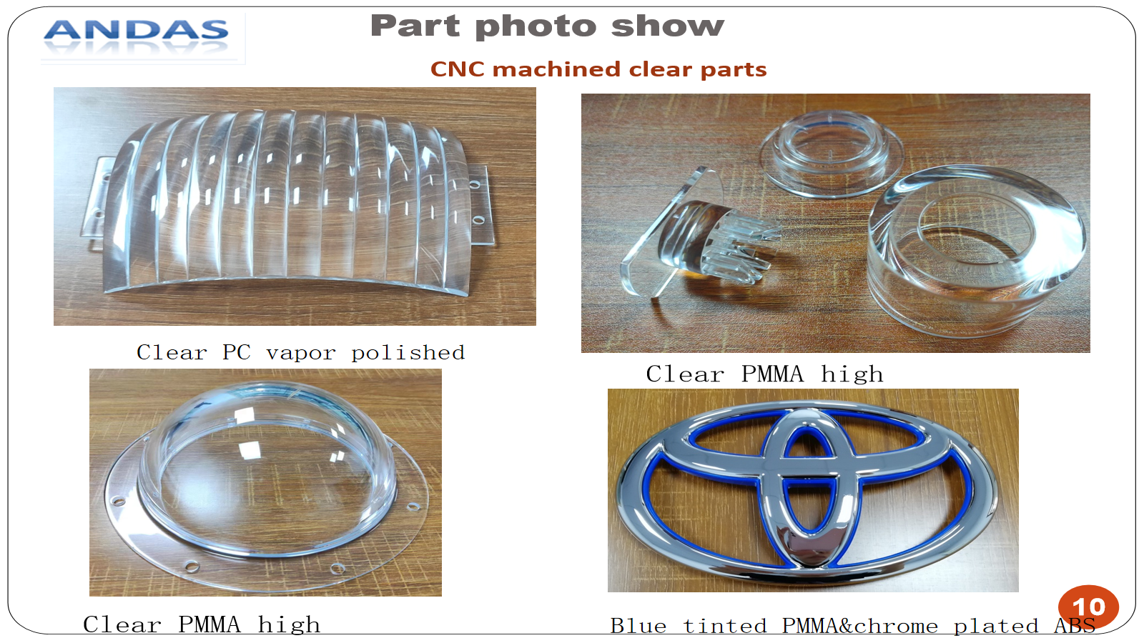
Plastic & Clear Part Capability
• CNC machined ABS, POM, HDPE, PC and PMMA prototypes
• Clear PMMA / PC parts with polishing or vapor polishing where applicable
• Painted appearance models and functional prototype housings
• Fit, appearance and material behavior are reviewed by project
Andas Industrial Co., LTD | andas-industrial.com | ISO 9001

Slide 8
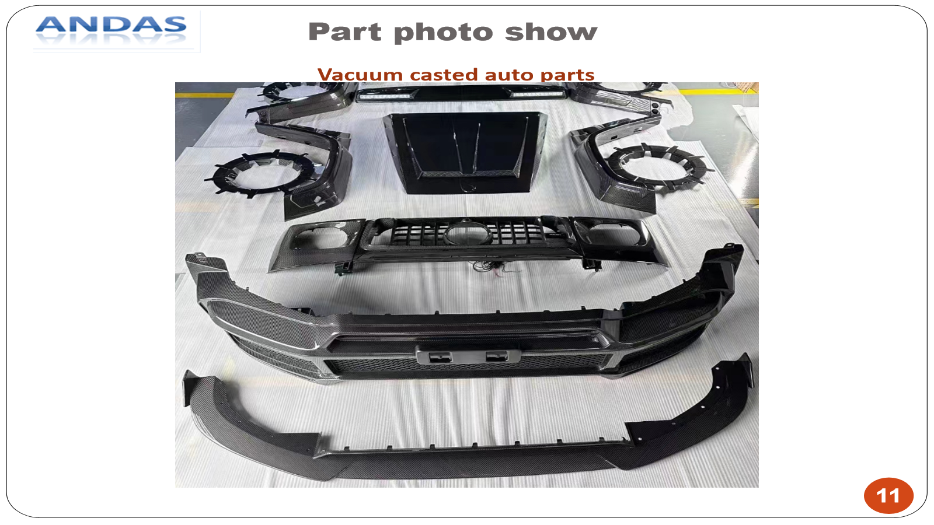
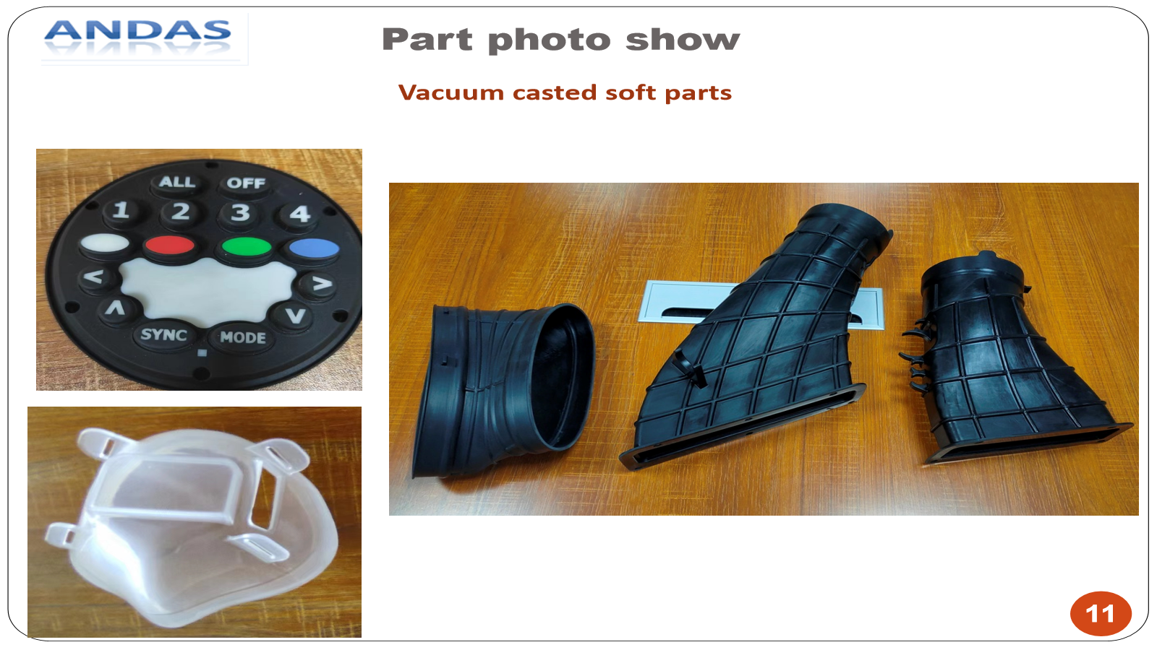
Vacuum Casting & Small Batch
• Suitable for 10–100 pcs prototype plastic parts
• Silicone mold process from a master model
• PU casting materials can simulate ABS-like, PP-like, rubber-like and PMMA-like properties
• Best used for appearance models, functional checks and low-volume validation
Andas Industrial Co., LTD | andas-industrial.com | ISO 9001

Slide 9
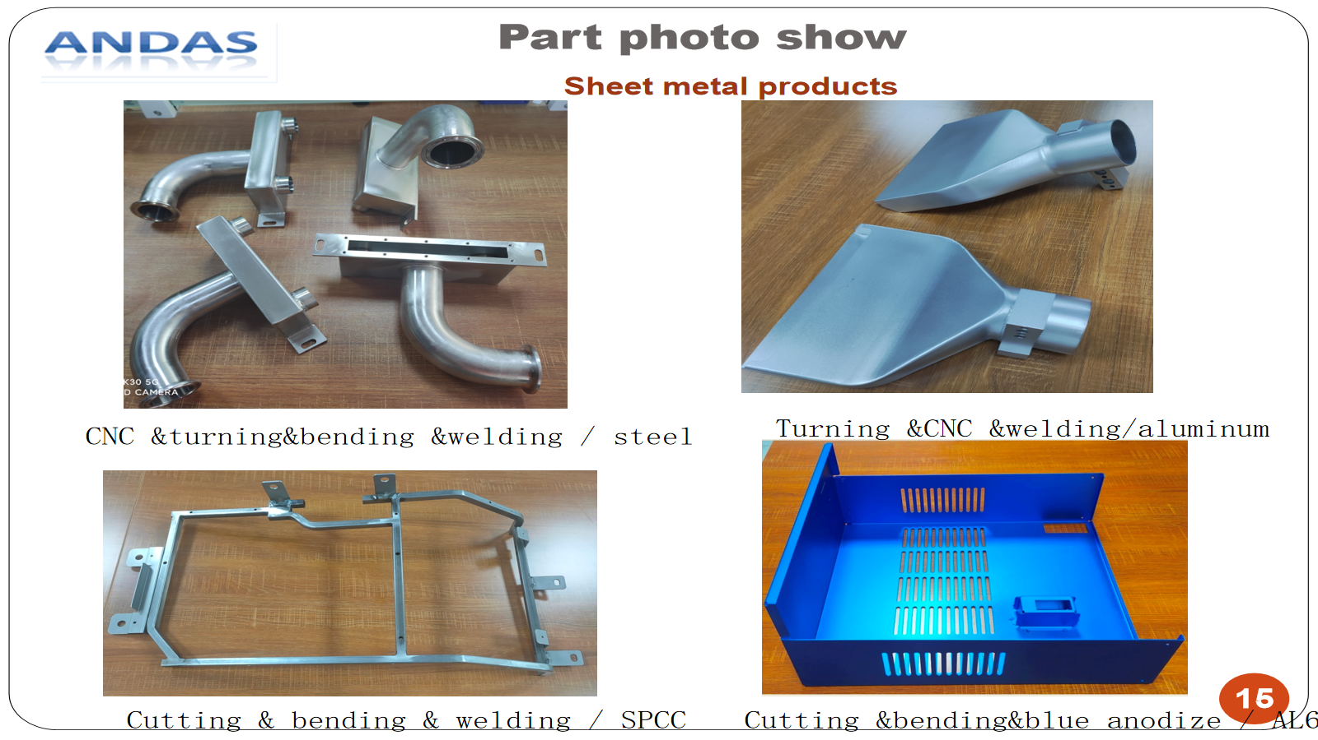
Sheet Metal & Finishing Support
• Sheet metal cutting, bending and welding support
• Finishing coordination: painting, anodizing, plating, powder coating, chromating and sand blasting
• Laser marking, tapping, welding and assembly-related secondary operations by project
• Finishing requirements are confirmed against drawing, material and function
Andas Industrial Co., LTD | andas-industrial.com | ISO 9001

Slide 10
Quality & ISO 9001 Workflow
• ISO 9001 quality management
• Drawing and production-route review before quotation
• Critical dimension checks and inspection photos available on request
• Material and finishing confirmation before production release
• CMM / FAIR / MTR documentation can be arranged by project requirements
Andas Industrial Co., LTD | andas-industrial.com | ISO 9001

Slide 11
Project Scope & Compliance
• Medical-device projects are not accepted.
• Products restricted or prohibited for export under current Chinese regulations are not accepted.
• Production route, inspection plan, compliance boundary and documentation requirements are confirmed before order.
• For uncertain end-use or export status, Andas may decline the project before quotation.
Andas Industrial Co., LTD | andas-industrial.com | ISO 9001

Slide 12
Contact Andas
Send drawings, samples or project requirements for review.
• Website: https://andas-industrial.com/
• Email: sales@andas-industrial.com
• WhatsApp: +86 157 1082 9371
• Location: Guangdong, China
• NDA available on request before sensitive drawing review
Andas Industrial Co., LTD | andas-industrial.com | ISO 9001

